Slide 1
Probe Data Analysis for Road Slope
Assignment 2
Submitted By:
Arpit Hasmukhbhai Patel – A20424085
Hitanshu Rami – A20458137
Hariharan Shankar - A20442562

Slide 2
Assignment-2
Input:
The raw probe points collected over several months
The link data for the links that probe points can be map-matched to
Task:
Map match probe points to road links
Derive road slope for each road link
Evaluate the derived road slope with the surveyed road slope in the link data file

Slide 3
What is Probe Data?
Data that is generated by monitoring the position of individual moving objects (i.e., probes) over space and time.
All Moving Objects: Vehicles(cars, buses, trains), pedestrians etc. are examples.
A time series of locations (x1,y1,t1),(x2,y2,t2)... Is the data for each probe.
Probe data is a good source of information on transport demand patterns and performance of the transport network.
Probe data is useful in many ways such as: to determine traffic speed, transportation analysis, map creation/refinement etc.

Slide 4
Introduction of Map-Matching
Map matching is performed by obtaining probe data and then mapping it to the map using the given information like latitude, longitude, timestamp, elevation etc.
Map-matching algorithm integrate probe data with road link data to identify the correct link on which a vehicle is travelling and to determine the location of vehicle on a link.
It helps in identifying inaccuracy of positioning, off the road locations, error of a GPS point etc. The error of GPS point is corrected by snapping the GPS point onto the road network.
Map-matching algorithms are Probabilistic theory, Fuzzy Logic, Klaman filter etc.

Slide 5
Approach
Map-Matching
The GPS probe data collected is mostly inaccurate and can be accounted to the noise and sparseness of the data, which paves way to the concept of map matching where in we try and map the individual probe data points to the closest link/segment which forms a part of the complete path. This process is termed as map-matching.
Partition6467linkdata.csv file is read in MatchingProbeData.py file where we used open() and reader functions.

Slide 6
Approach
Map-Matching
Latitude and Longitude are given in both Probe Data and Link Data.
To Map-Match we use these Latitude and Longitude information of both these files and compare them with every other to find the one-pair with minimum distance between them.
So, this pair is resultant Map-Matched Probe data points to corresponding Link.

Slide 7
Approach
Slope Calculation
Haversine Formula is being used to determine the great circle distance between any two points on a sphere given their coordinates in the form of latitude and longitude.
Haversine Formula is given as:
a = square of half of the chord length between the points
c = angular distance in radians
R = radius of Earth in km
φ = latitude in radians
λ = longitude in radians
a = sin²(Δφ/2) + cos φ₁ ⋅ cos φ₂ ⋅ sin²(Δλ/2)
c = 2 ⋅ a.sin( √a )
R = 6371*1000

Slide 8
Approach
Slope Calculation
To calculate the slope between two points we use the matched points from previous step to calculate the slope of two consecutive points.
The slope between two consecutive points(A1, A2) is Y2-Y1/X2-X1 where A1(X1,Y1) and A2(X2, Y2) are the two points.
The difference between the heights of probe points can be calculated using the data in the provided link segment csv.[Y2-Y1]
But for the [X2-X1] we need to use the haversine distance.
This is calculated for all consecutive pairs of the matched points.

Slide 9
Approach
Evaluation of Derived Road Slope with surveyed road slope
Slope is then averaged across all the link points.
The slope is then compared with the given slope.
If each link has a has a matched points which we have appened during calculating slope for each of the link data points.
These data points is passed for evaluation and if it is non-zero we will calculate mean of slopes i.e we find both mean for given slope and calculated slope.
These slopes are written in evaluated_data.csv file.

Slide 10
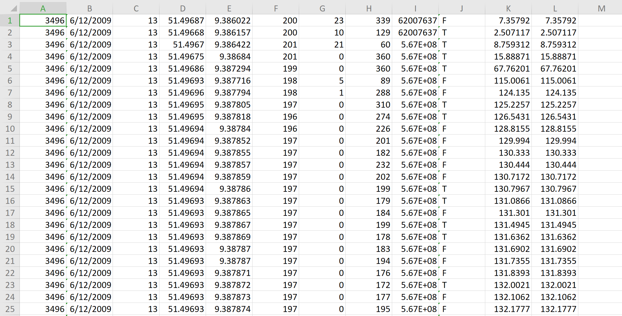
Result
Screenshot of MatchedPointsOutput.csv file. Here all link and probe files are compared with every other to find the one-pair with minimum distance between them.

Slide 11
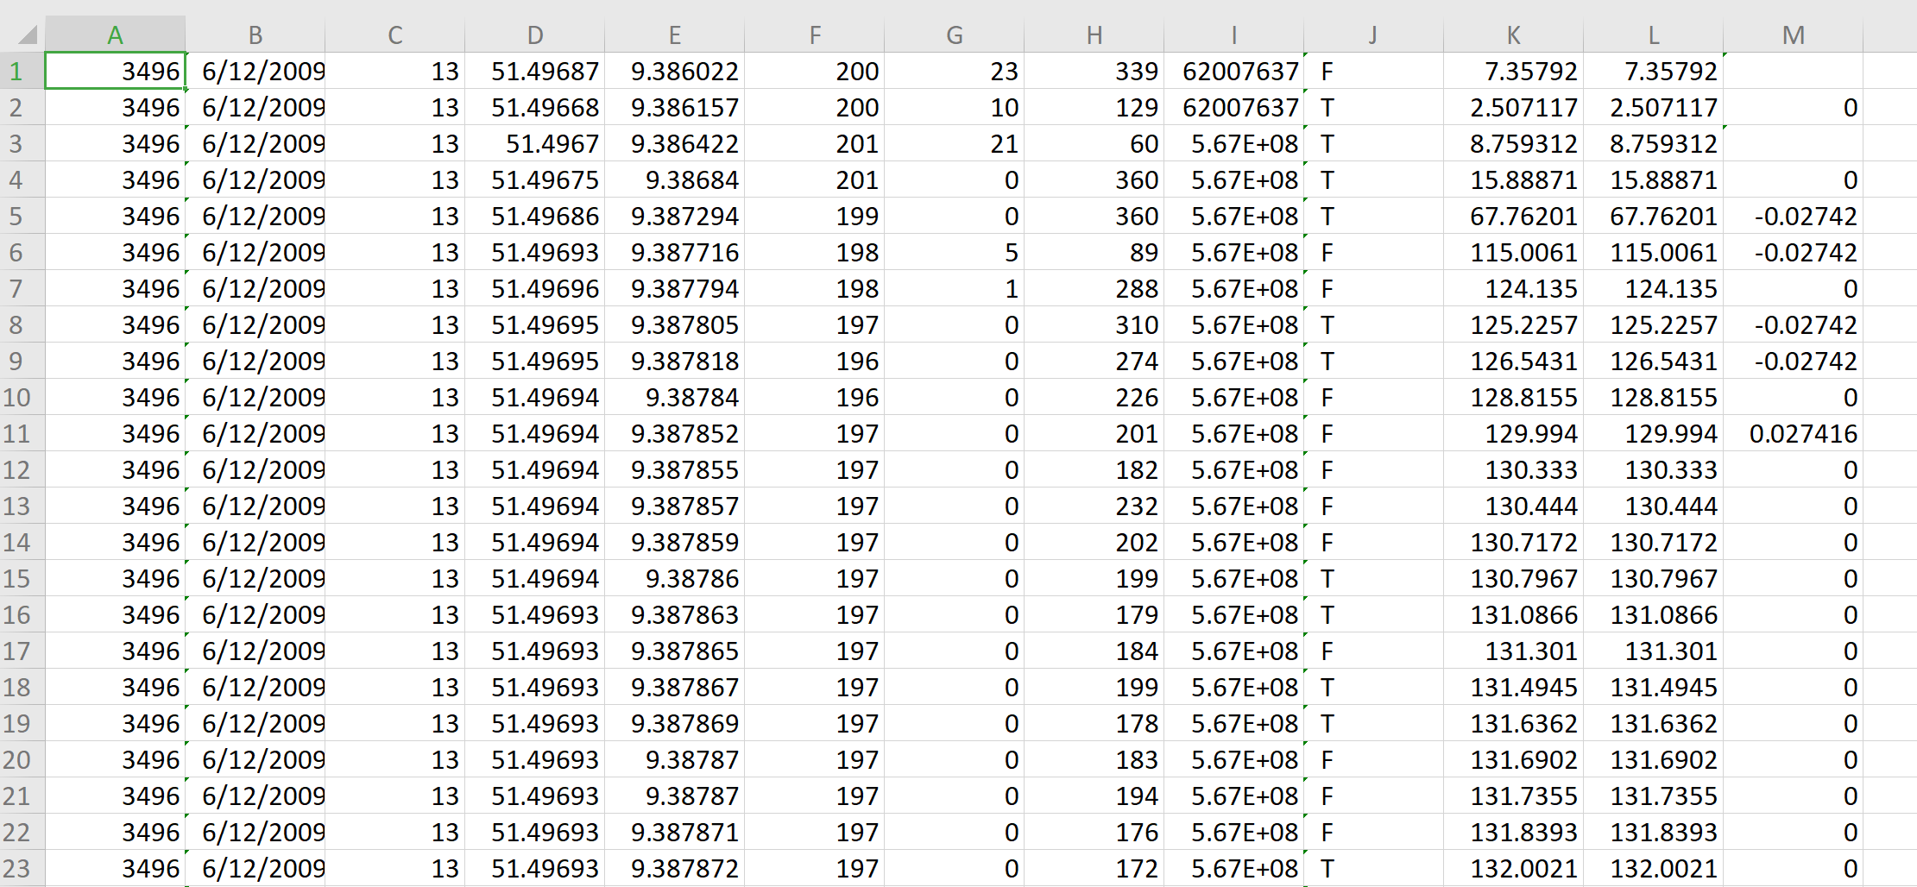
Result
Screenshot of slope.csv. The slope between two consecutive points from matched points are used to calculate the slope.

Slide 12
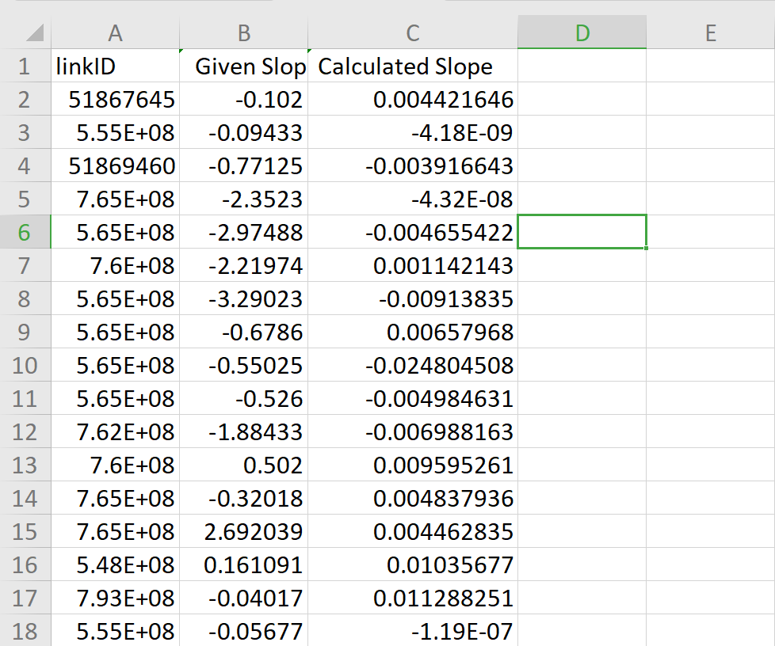
Result
Screeenshot of evaluated_data.csv. Given slop and calculated slope of each matched data points is written in this csv file.

Slide 13
Conclusion
We were able to obtain some matching slope values when we compared our calculated slope values with the given slope values.
We can thus make an inference that if we get enough probe points for a link, we are able to calculate the slope of a link to an acceptable precision.

Slide 14
References
Yuan, Jing, et al. "An interactive-voting based map matching algorithm." Mobile Data Management (MDM), 2010 Eleventh International Conference on. IEEE, 2010.
https://www.researchgate.net/publication/226834033_An_off-line_map-matching_algorithm_for_incomplete_map_databases
http://web.mit.edu/jaillet/www/general/map_matching_itsc2012-final.pdf
Lou, Yin, et al. "Map-matching for low-sampling-rate GPS trajectories." Proceedings of the 17th ACM SIGSPATIAL international conference on advances in geographic information systems. ACM, 2009.

